Slide 1
2022 Synopsys ARC AIoT Design Contest - 決賽作品
Foodie Fortress
智慧冰箱管理系統
隊名： 709 板板之王
成員：朱育欣、謝瑞峰、林育萱
指導教授：張俊盛

Slide 2

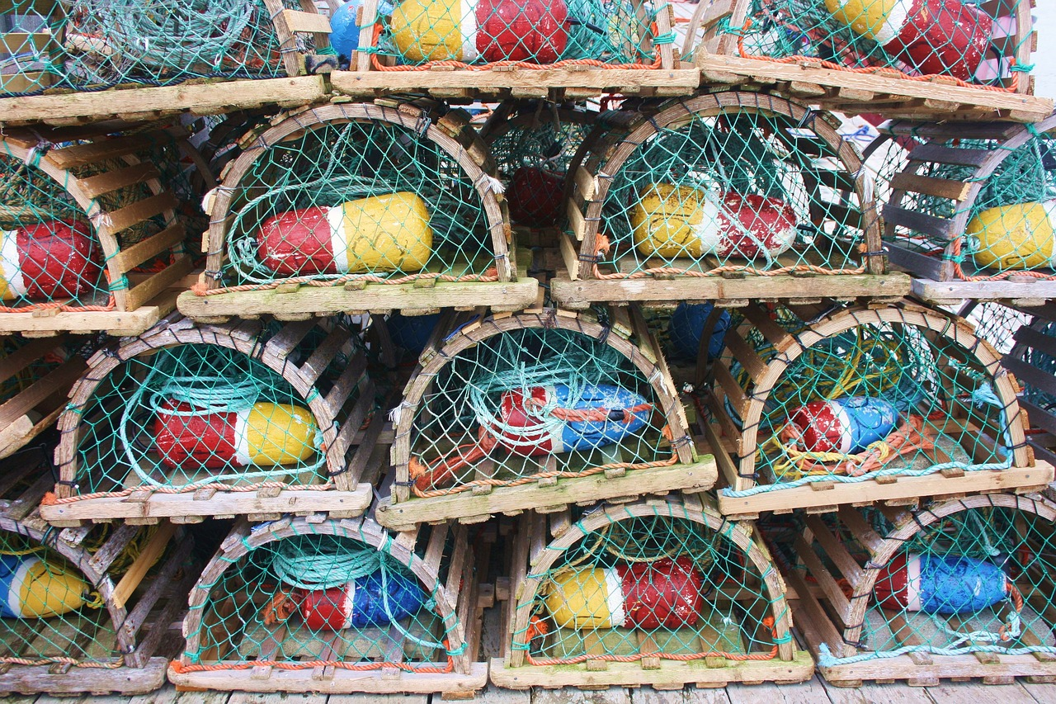

User Pain Point
你的共用冰箱是不是有這種問題？
不小心誤吃到 別人的食物
被遺忘的食品
佔據空間、腐敗
出門購物時 忘記要添購的食材
Notes:
不知道大家有沒有遇到這個問題

Slide 3

FoodieFortress 智慧冰箱管理系統
AI+IoT技術保護食品歸屬，記錄存取紀錄，提醒食品新鮮度解決共用冰箱誤取、過期食品和食材選購的問題。
Notes:
所以我們提出了

Slide 4
Agenda
System Introduction
Model Overview
System Architecture
Conclusion

Slide 5
System Introduction

Slide 6
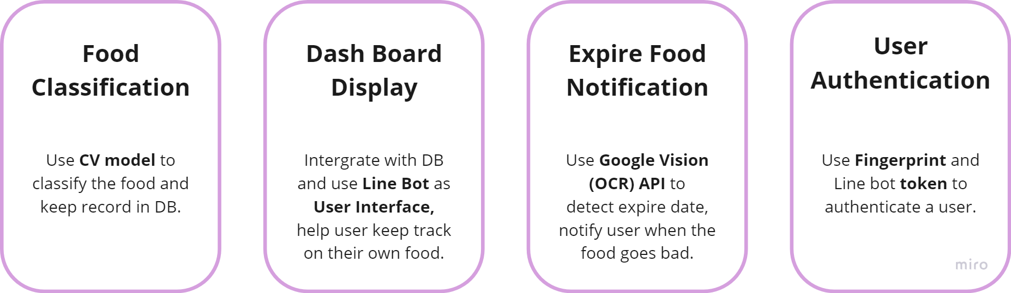
System Features

Slide 7
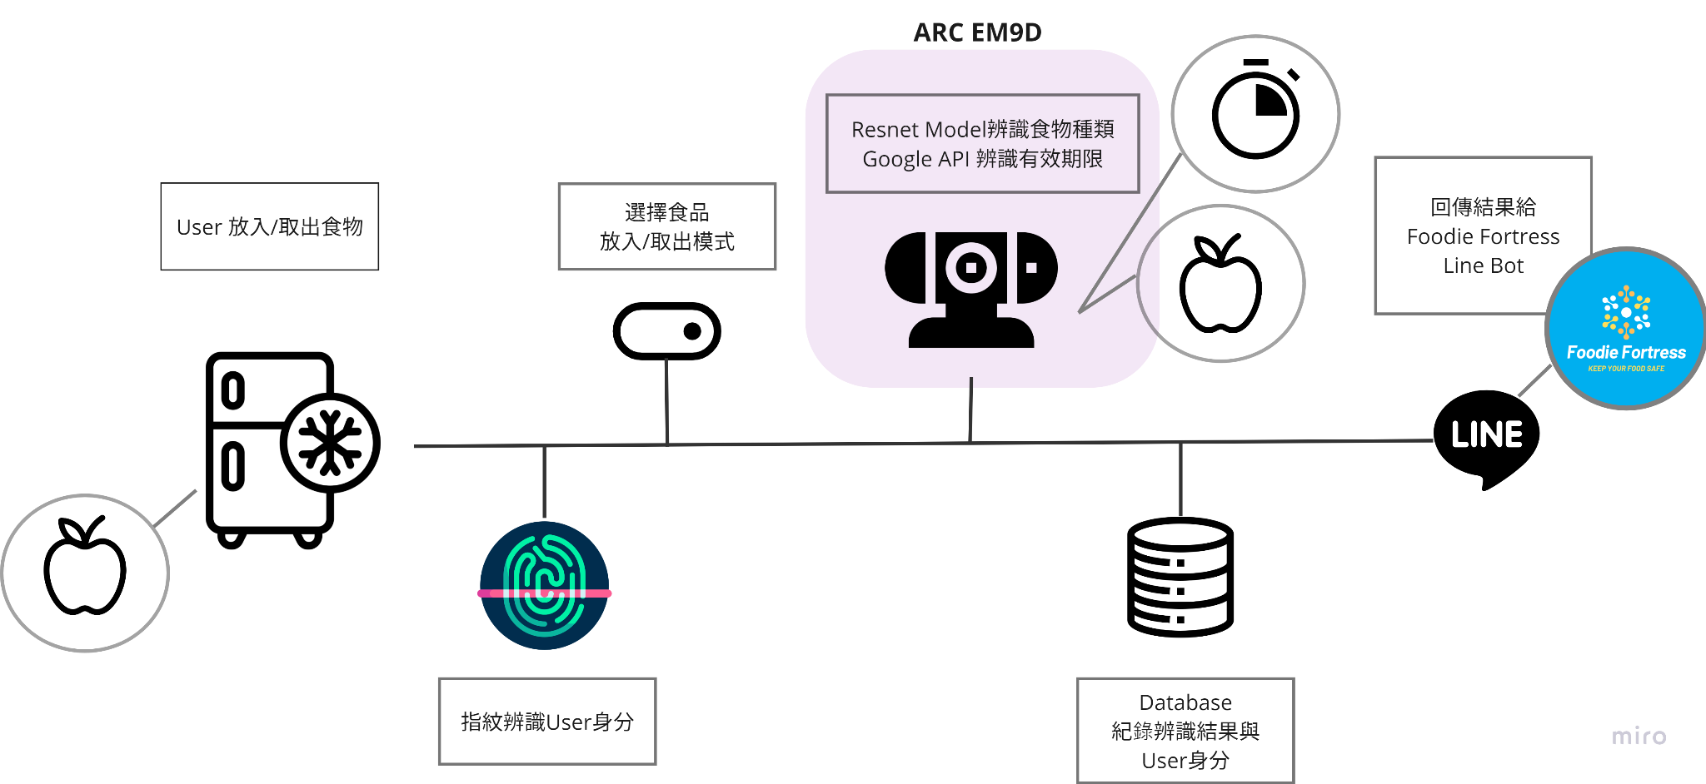
System Process

Slide 8
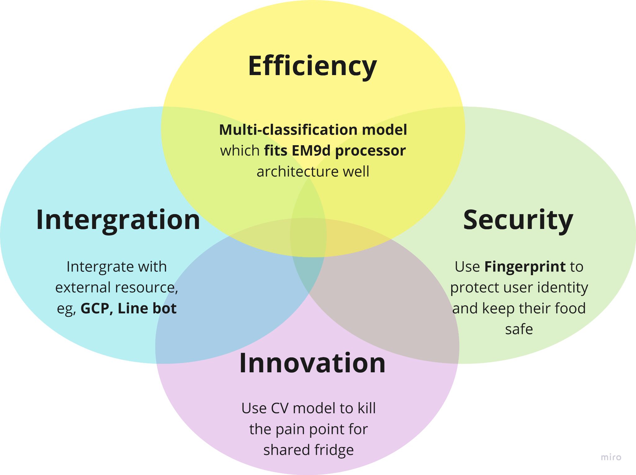
System Strengths

Slide 9
2. Model Overview
Food Classification Model

Slide 10
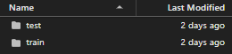
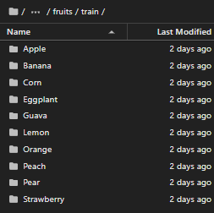
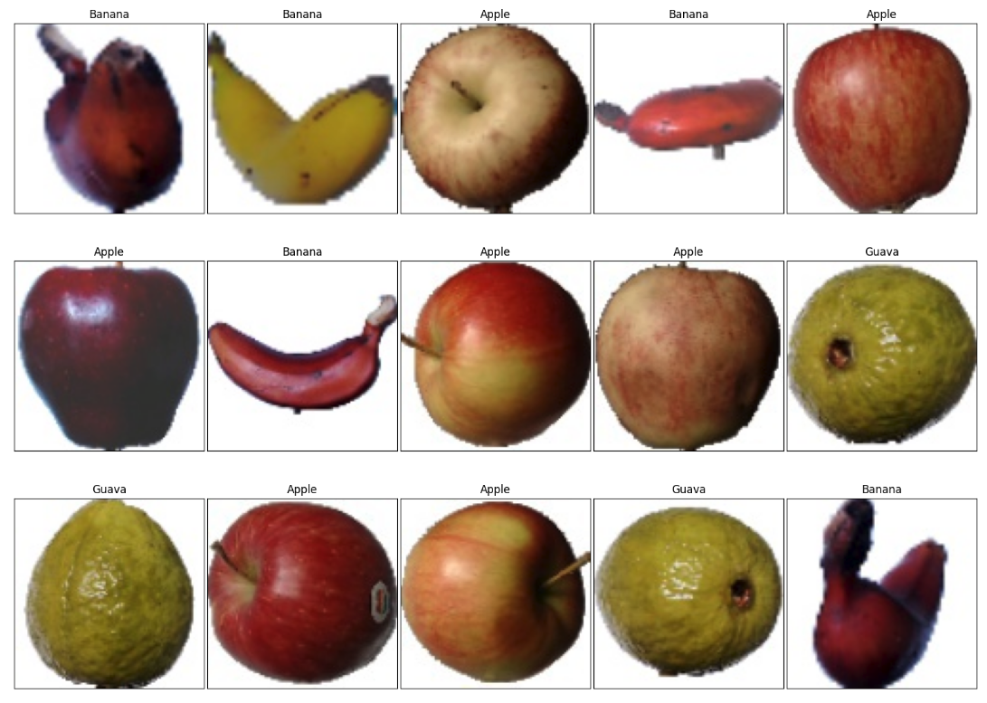
Dataset ：Fruits360 + Self-generated dataset
以資料集為Fruits360為基礎
Kaggle public dataset, over 2600 upvote fruit pictures
Take 10 class as below, and ~440 pictures for each class： Apple Banana Corn Eggplant Guava Lemon Orange Peach Pear Strawberry
Notes:
train/val八比二

Slide 11
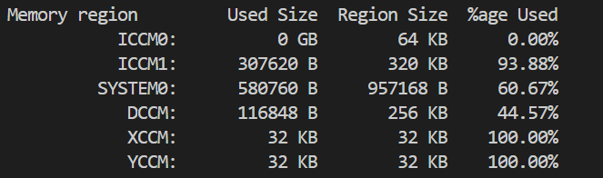
Difficulties
Memory Limitation：System0 < 957168 B
困境：大部分CV model 參數太多
Low muli-class accuracy： 困境：黑白圖片難以達成食物辨識的多種Class分類
→ Custom ResNet Model

Slide 12

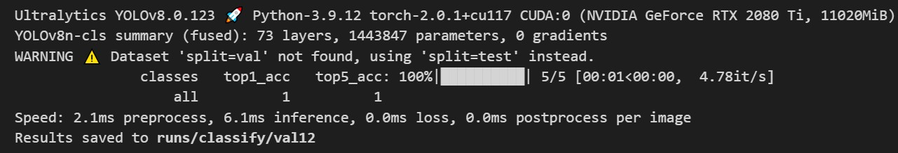
Classic CV Model Comparison
 | Yolov8-cls | Custom CNN Sequential | Custom-ResNet
Total Parameters | ~2.7M | ~50K | ~70K
Tflite Accuracy | 0.92 | 0.53 | 0.7

Slide 13
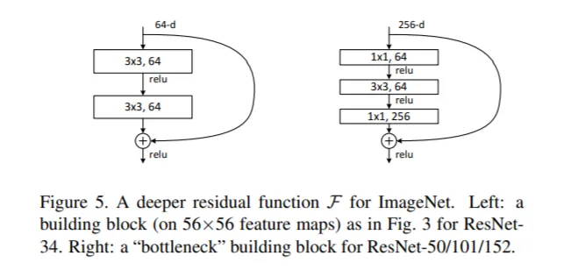
Preliminary: ResNet
解決Degradation Problem： Convolution層 中間多開了直通連路(Skip Connection)，將每一層的輸出改成 原本學習到的特徵 + 上一層的結果， 解決Degradation Problem。
降低學習難度： 直通連路與卷積層 直接相加而非用連接的方式，將學習目標改為降低殘差(Residual)，降低模型學習難度。
減少模型參數量： 殘差塊使用 bottleneck形式， 將3x3卷積核拆成1x1, 3x3, 1x1卷積核，可以在減少模型參數量的同時兼 顧到更高的維度。

Slide 14
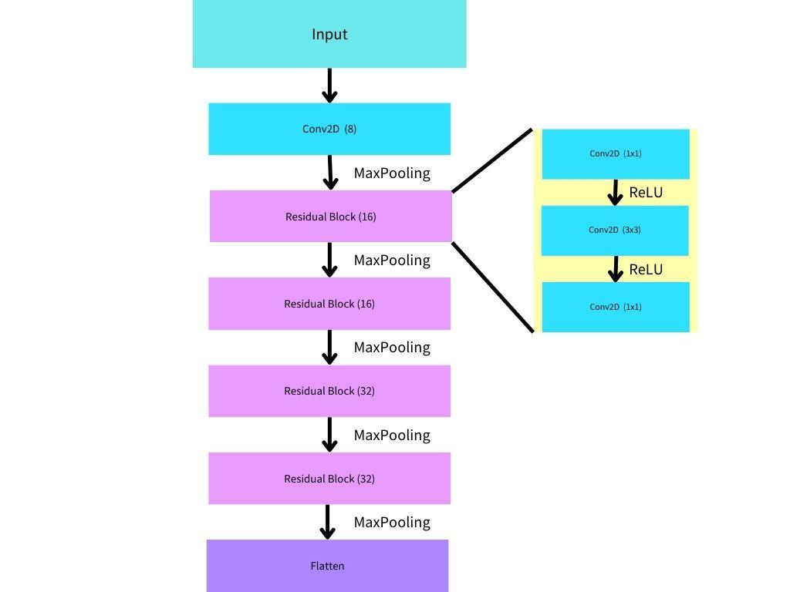
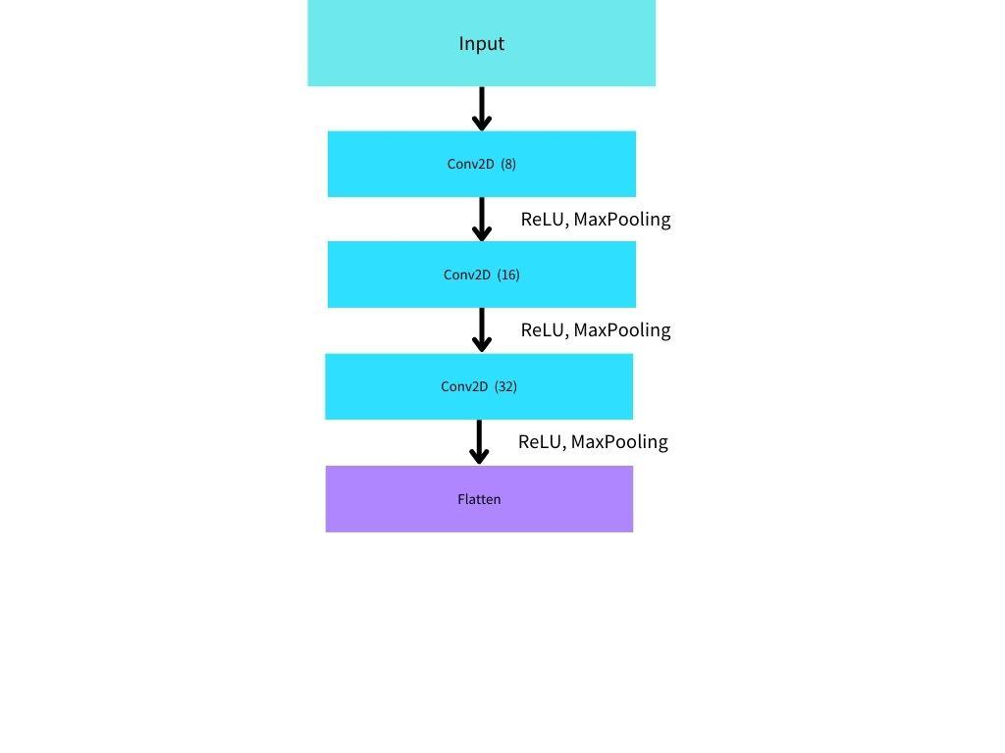
Custom ResNet vs. Common Sequential Model
ResNet significantly improved the accuracy
with acceptable numbers of parameters.
 | Sequential | Custom-ResNet
Total Parameters | ~50K | ~70K
Tflite Accuracy | 0.53 | 0.7
Common Sequential
Custom-ResNet
Notes:
不增加餐數量的情況畫，我們達成更多層

Slide 15
Hardware Compatibility with EM9D processor
Low Latency Three-Stage Pipeline: Residual blocks can be efficiently executed in a low latency three-stage pipeline due to its relatively shallow depth.
Low Power Consumption: ResNet models, especially those with fewer parameters, can be computationally efficient, which aligns well with the processor's goal of achieving low power consumption.
source: ARC EM9D and EM11D RISC + DSP Processors datasheet
Notes:
Residual blocks in ResNet have a simple structure with two sets of convolutional layers and an element-wise addition operation. As a result, the computations involved in residual blocks can be completed in a few cycles, making them well-suited for a low-latency pipeline.

Slide 16
3. System Architecture

Slide 17
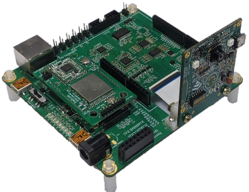
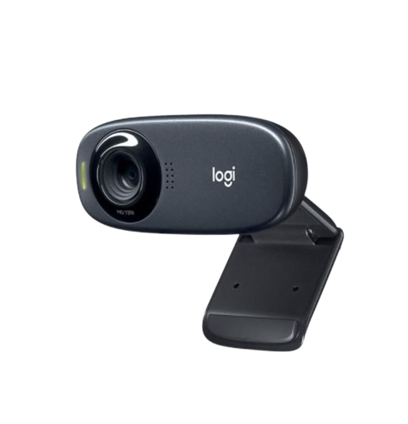
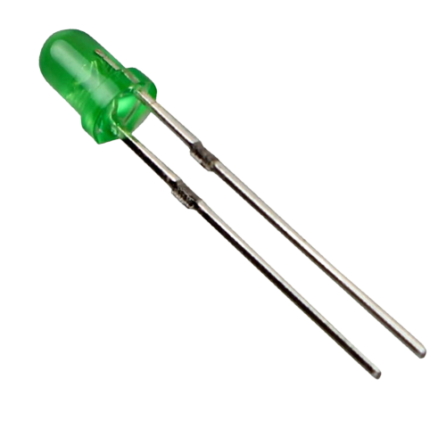
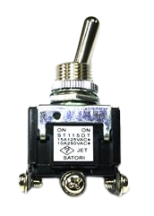
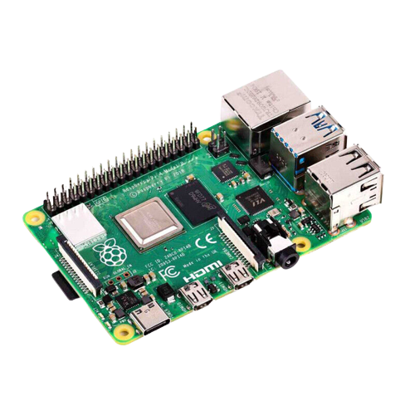
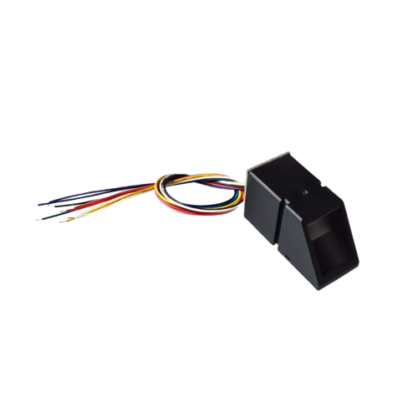
Hardware Architecture
ARC EM9D AIoT DK
Web Camera
LED 燈
GPIO
control
USB 3.0
UART
兩段式開關
光學指紋感應器
Raspberry pi 4
GPIO
control
GPIO
control

Slide 18





System Architecture
Custom Resnet:
Food Classification Model
Google Vision API
ARC EM9D AIoT DK
開發板
彩色鏡頭（冰箱內）
Database
光學指紋感應器 (門把上)
UART
指紋辨識模組
Line Bot
Raspberry Pi
Model 4
HTTP Request
wifi
LED燈
data transmit direction
wired connection
wireless connection

Slide 19
Hardware Spec
ARC EM9D AIoT DK 開發板
光學指紋感應器：AS608 Optical Fingerprint Reader Sensor Module
食品影像辨識鏡頭：Logitech c310 webcam
Raspberry Pi 4

Slide 20
Software Spec
食品辨識模型
CV CNN model：Self-Develop ResNet Model
Dataset：Fruits360
指紋辨識模型
User Interface：Line Official
Database：MySQL Lite

Slide 21
4. Conclusion

Slide 22
Benefit of FoodieFortress
解決共用冰箱問題
設計Custom Restnet Model
食物不會被亂拿、
不再有過剩食品佔據空間。
Multi-class的 food classification model，符合Em9d處理器特性

